Slide 1

Probability Review
Presented by:
Elizer Ponio Jr.

Slide 2
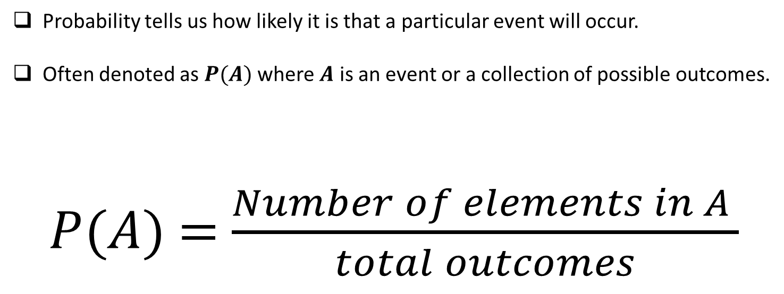
What is Probability?
Probability tells us how likely it is that a particular event will occur.
Often denoted as $P(A)$ where $A$ is an event or a collection of possible outcomes.
$P$($A$) = $\frac{Number of elements in A }{total outcomes}$

Slide 3
Sample Space
Sets of all possible outcomes that can occur.

Slide 4
Sample Space
What are the possible outcomes of flipping one coin?
1 Coin → H, T
S = {H,T}

Slide 5
Sample Space
What are the possible outcomes of flipping two coins?
COIN 1 | COIN 2
Heads | Heads
 | Tails
Tails | Heads
 | Tails
S = {HH, HT, TH, TT}

Slide 6
Sample Space
What are the possible outcomes of flipping three coins?
COIN 1 | COIN 2 | COIN 3
Heads | Heads | Heads
 |  | Tails
 | Tails | Heads
 |  | Tails
Tails | Heads | Heads
 |  | Tails
 | Tails | Heads
 |  | Tails
S = {HHH, HHT, HTH, HTT, THH, THT, TTH, TTT}

Slide 7

What is Probability?
The probability of an event occurring is always between zero and one.
0 ≤$P$($A$) ≥ 1
If the probability is zero, then that event will never happen.
If the probability is one, then that event will always happen.

Slide 8
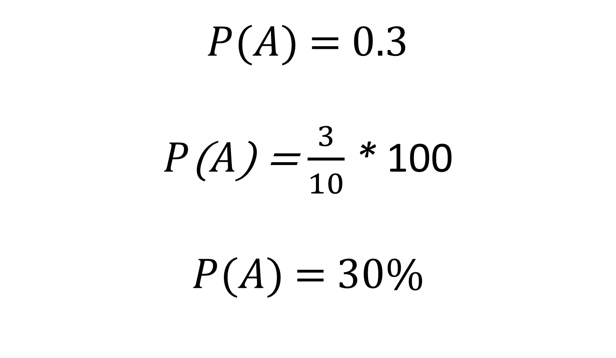
What is Probability?
$P$($A$) = 0.3
$P$($A$) = $\frac{3}{10}$ * 100
$P$($A$) = $30\%$

Slide 9
Practice Problem
If two coins are flipped, (a) what is the probability of getting at least one head? (b) if three coins are flipped, what is the probability of getting at least two tails? (c) If three coins are flipped, what is the probability of getting exactly one tail?

Slide 10


Practice Problem
(a) what is the probability of getting at least one head?
S = {HH, HT, TH, TT}
A = {HH, HT, TH}
$P$($A$) = $\frac{3}{4}$ * 100
$P$($A$) = 75%

Slide 11


Practice Problem
(b) if three coins are flipped, what is the probability of getting at least two tails?
S = {HHH, HHT, HTH, HTT, THH, THT, TTH, TTT}
A = {HTT, THT, TTH,TTT}
$P$($A$) = $\frac{4}{8}$ * 100
$P$($A$) = 50%

Slide 12


Practice Problem
(c) If three coins are flipped, what is the probability of getting exactly one tail?
S = {HHH, HHT, HTH, HTT, THH, THT, TTH, TTT}
A = {HHT, HTH, THH}
$P$($A$) = $\frac{3}{8}$ * 100
$P$($A$) = 37.5%

